Slide 1



SESSION NAME HERE
English for Tech Professionals
Lecture 1 - Business Communication

Slide 2

Learning Objectives and Outcomes
By the end of this lesson, students should be able to:
Explain the importance of effective communication in the tech sector
Apply best practices for presentation in written and spoken communication
Determine which digital and AI tools are best to help with business communication and how to use them

Slide 3



Why is knowing how to communicate effectively so important in Tech, considering the rise of AI-assisted technology?
It’s handy no matter what your eventual job
Eliminates confusion / makes your work easier
Knowing how to search and prompt will help so much more
It will augment your work and way of thinking
It will set you apart - do better work, find better jobs, sell ideas
Transferable skills
Like programming, the better you know the language the better the code
You may just be spared in the robot uprising

Slide 4


Lecture 1 - What to expect
Professional and Business Communication
Programming Languages vs The English Language
Understanding Your Audience Technical, non-technical, professional
Relevant Software / AI Tools What they are, how they can help you
Business Communication Examples of where and how to use it
Work through 2 examples of business communication Start with the basics, iterate and improve
Presentation Skills - written and verbal Tips and tricks
CONFIDENTIAL
Practice session - writing a cover letter

Slide 5
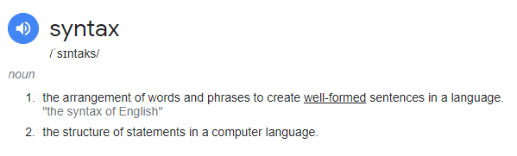
Programming Languages vs The English Language
Both have syntax

Slide 6
Programming Languages vs The English Language
Semantics versus Syntax (Loops, functions, strings, variables, etc)
SEMANTICS = MEANING ; SYNTAX = ARRANGEMENT
WHAT you communicate vs HOW you communicate
Both are used to communicate - ideas vs instructions / creativity versus rigidity
Both have rules - you can break them in English, but not in programming
If a line of code contains an error it doesn’t work / English grammar/meaning is variable - “it’s a feature, not a bug”
Approaching English like programming can be both helpful and harmful

Slide 7

Programming Languages vs The English Language

Slide 8
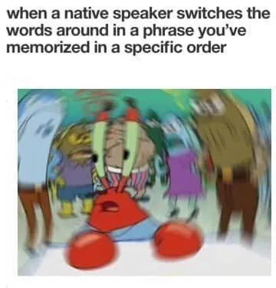
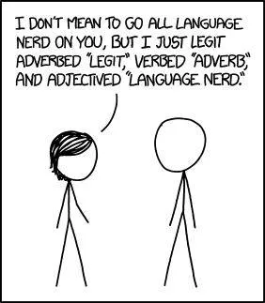
Programming Languages vs The English Language

Slide 9
Understanding Your Audience
… so that they understand you
The first step to any communication - put yourself in their shoes
Writing is about reading / writing is about empathy
What do they need to know / what do they not know
Tailor your message for them
Don’t over or under-explain
TECHNICAL:
Fellow developers / team members
Online communities
NON- TECHNICAL:
Non-dev team members
Clients
End Users
Interviewers
Recruiters
CONFIDENTIAL

Slide 10
Understanding Your Audience
TECHNICAL
e.g. Fellow developer
Code comments
Software updates
User Manual
NON-TECHNICAL
e.g. Client
Proposal / pitch
Updates
Explaining features
COMBO
e.g. UX/UI Designer
Changes to make
Problems to solve
Questions
LANGUAGE - TERMS - TONE

Slide 11
Proactive Communication vs Constructive Communication
Proactive Communication
Logistics - “going to be AFK for an hour”
“Everyone needs to do migrations”
“Watch out for this bug”
Clarification - asking questions before you start something
Thinking ahead
Constructive Communication
Pull requests to GitHub
Asking questions of team members
“It seems the way that you built this modal is in conflict with the pattern that we have in the rest of the app, does that seem to be the case to you?”
As opposed to “this code is wrong, fix”

Slide 12
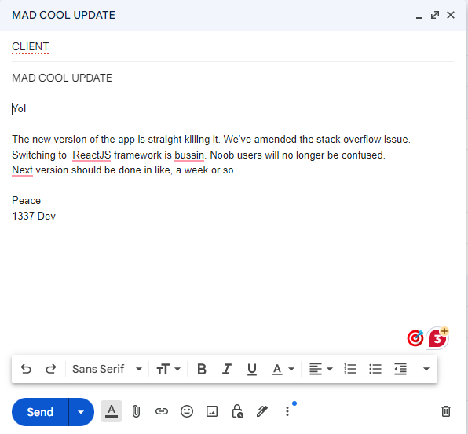
Understanding Your Audience - example 1 - CLIENT

Slide 13
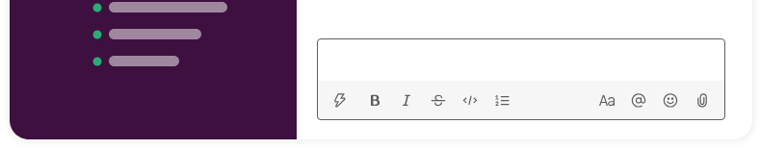
Understanding Your Audience - example 2 - DESIGNER
Make the green clicky thing blue, update the style sheet, make the font on the homepage Comic Sans

Slide 14


Slide 15
TOOLS
Spelling and Grammar Check (MS Word, Google Docs)
Grammarly
ChatGPT
Gemini (formerly Bard)
Businessenglish.ai
Skillsyncer
EdApp AI Translation Tool
Jenni AI
Miscellaneous Writing Assistants; Jasper, Wordtune, Copy.ai, Quillbot, Sudo Write, Copysmith, Moonbeam
CONFIDENTIAL

Slide 16
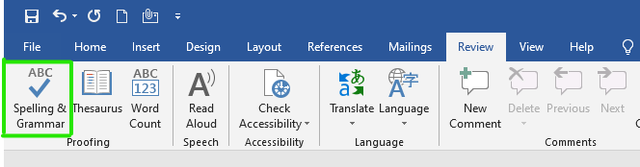
TOOLS - 1. Spelling and Grammar Check - MS Word
Select Review
> Spelling & Grammar or press F7.
In the Editor pane, select the correct spelling from the list of suggestions.
Select Change All to fix every time this word appears in your file.

Slide 17
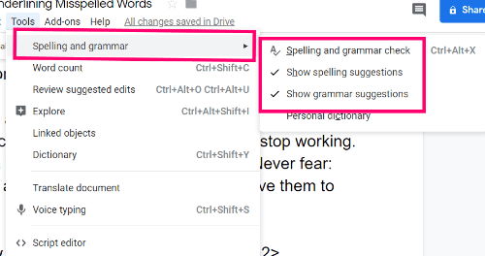
TOOLS - 1. Spelling and Grammar Check - Google Docs
Select Tools
> Spelling & Grammar
Select spelling and grammar check to check document
Check both options to track your content

Slide 18
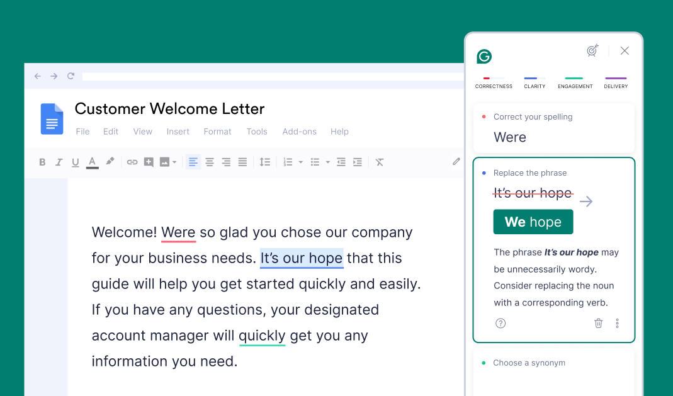
TOOLS - 2. Grammarly
Basic version is free
Can be used in browser as add-on (on top of built-in spell and grammar check)
Works in most programs as standalone app

Slide 19
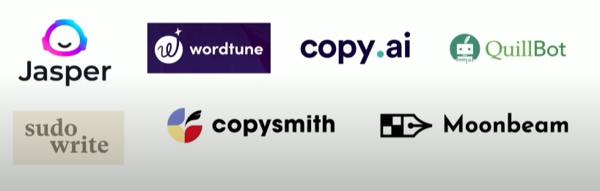
TOOLS - 2. Misc Writing Apps

Slide 20
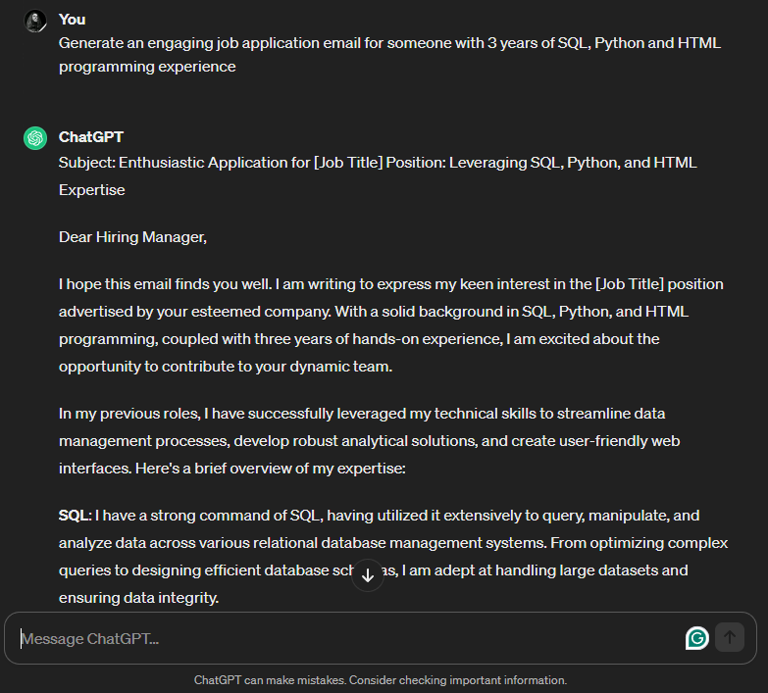
TOOLS - 3. ChatGPT / Gemini
Basic version is free
Can help write drafts / give ideas / speed up process
A great start, but not to be relied on fully
Can make mistakes
Research shows* it facilitates learning programming / motivation
* Source; The effect of generative artificial intelligence (AI)-based tool use on students' computational thinking skills, programming self-efficacy and motivation

Slide 21
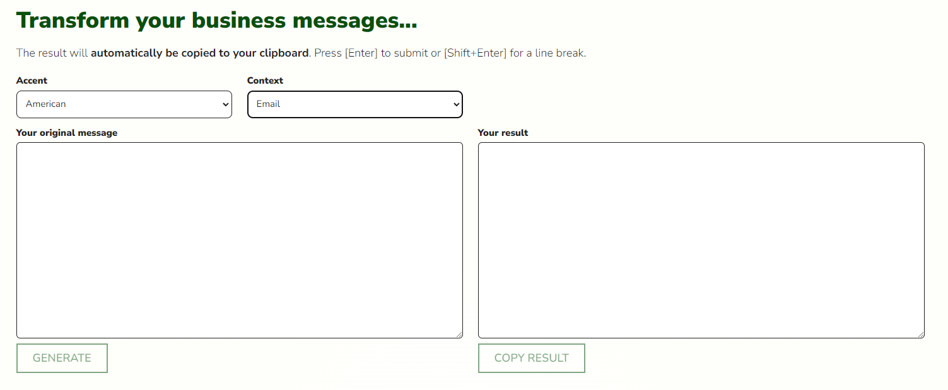
TOOLS - 4. BusinessEnglish.AI

Slide 22
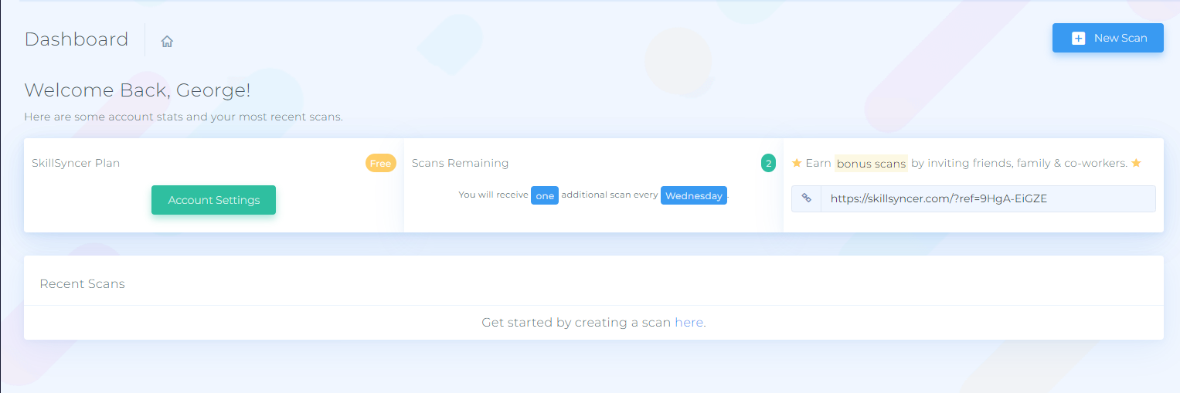
TOOLS - 5. Skillsyncer

Slide 23
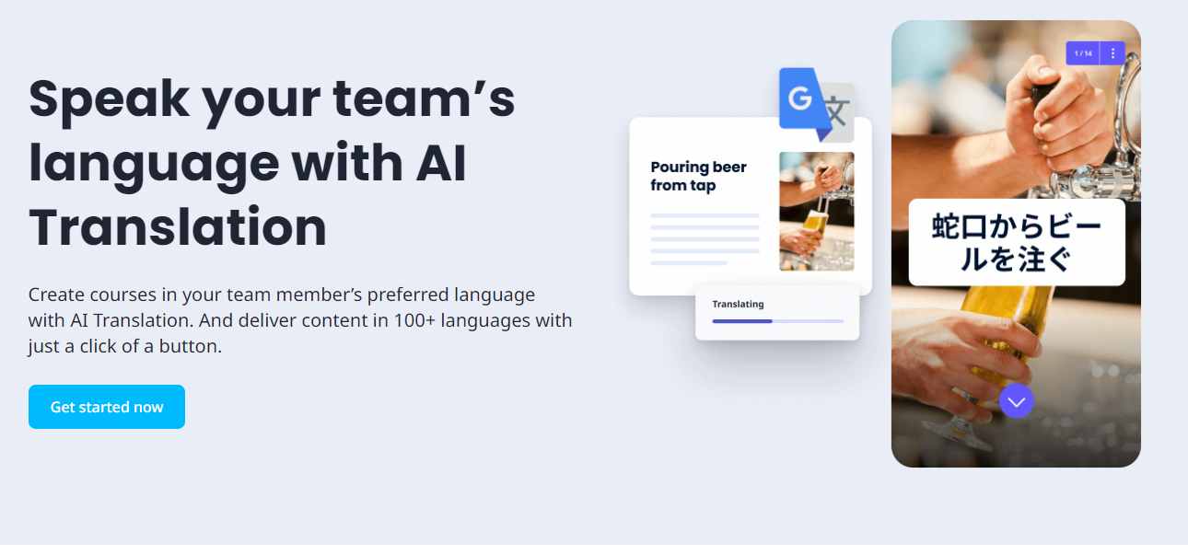
TOOLS - 6. EdApp Translation Tool

Slide 24
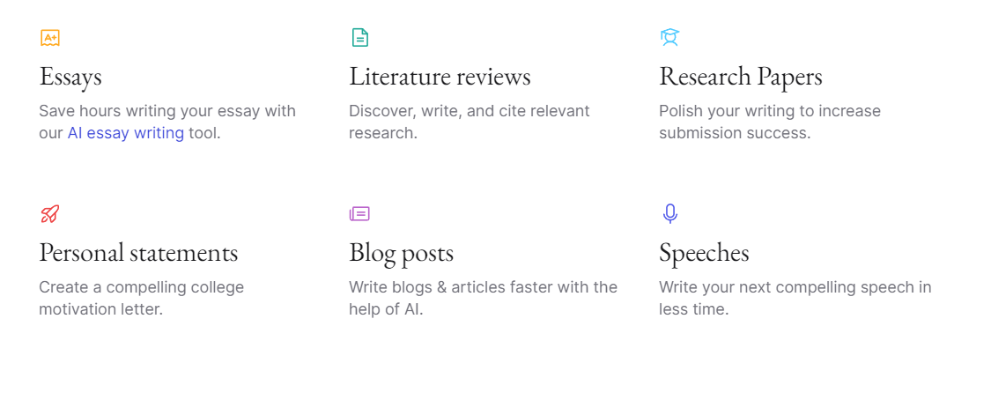
TOOLS - 7. Jenni AI

Slide 25
TOOLS - 9. Miscellaneous
Bearly AI - productivity and summarising
Fireflies - note-taking
Synthesia - create AI videos for presentations
Lavender.ai - writing in a specific voice

Slide 26
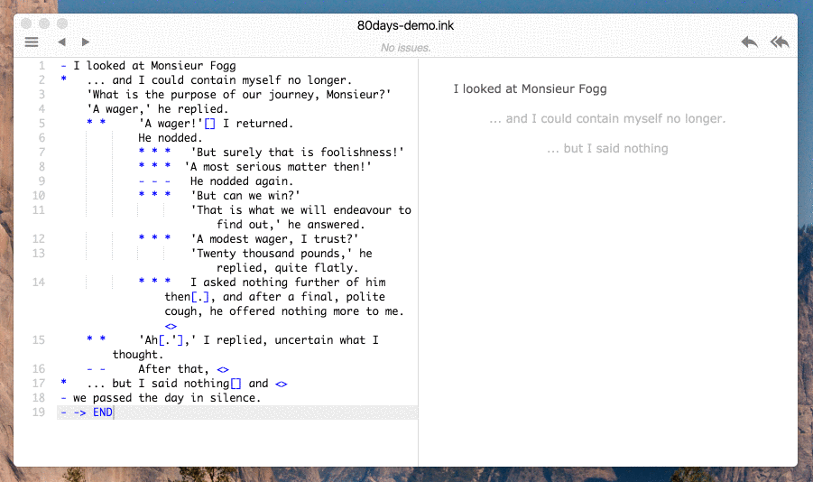
TOOLS - 9. Miscellaneous
Inky
Inky is an editor for ink, inkle's markup language for writing interactive narrative in games. It's an IDE (integrated development environment), it gives you a single app that lets you play in the editor as you write, and fix any bugs in your code.

Slide 27
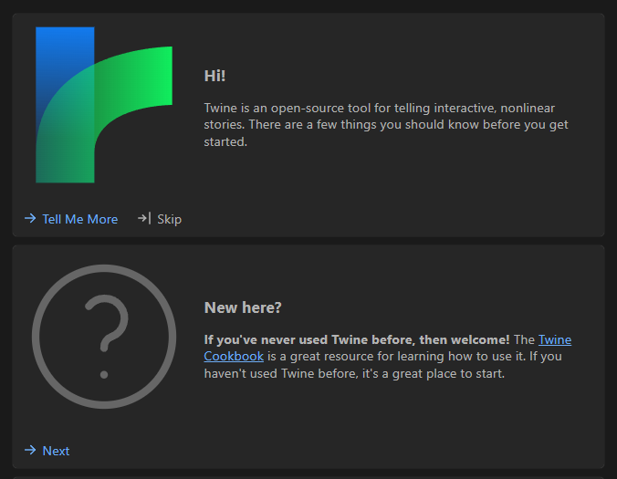
TOOLS - 9. Miscellaneous
Twine
Twine is an open-source tool for telling interactive, nonlinear stories.

Slide 28
How AI Can Help
What AI Cannot Do
Be more productive
Translate content
Solve complex problems
Learn faster
Write faster
Generate ideas
Prepare presentations
Replace Learning
Replace Experience
Replace Writing
Replace YOU
Much like in coding, AI can only do what you tell it to do

Slide 29


Slide 30
The Importance Of Business Communication In Tech
In one form or another, you’ll be faced with it
It needs to be clear to avoid confusion
It is representative of you or your company
You can learn transferable skills
CONFIDENTIAL

Slide 31
The Importance Of Business Communication In Tech
Applying for a job / self-promotion (portfolio)
Crafting a cover letter
Responding to written assessments for take-home tests in interviews
Drafting internal versus external business emails
Addressing interview inquiries during live interviews
CONFIDENTIAL

Slide 32
Written Communication
Applying For A Job / Self-Promotion / Portfolio / Cover Letter
Avoid slang
Avoid flowery language (not language about flowers, but excessive descriptions)
Use the correct terms (skills, programming languages, etc)
Don’t copy/paste from AI
Keep it concise
Mention relevant experience
Spell and grammar check

Slide 33
Written Communication
Example: GitHub Portfolio
“A portfolio is a compilation of materials that exemplifies your beliefs, skills, qualifications, education, training, and experiences. It provides insight into your personality and work ethic. A portfolio website is generally a static website featuring work samples and other details as explained above. It is closely related to Online Resume or C.V.”
GitHub profiles
Example: Simplefolio

Slide 34
Written Communication
Example: Cover Letter
Avoid slang
Avoid flowery language
Use the correct terms (skills, programming languages, etc)
Don’t copy/paste from AI
Keep it concise
Mention relevant experience
Spell and grammar check
Example: Cover Letter

Slide 35
Verbal Communication
Not everyone is a natural presenter, but there are things that can help.
If possible, prepare and practice
Be aware of your posture
Be aware of your intent
Try not to read, instead speak directly to people
Have material to back you up (slides, code samples, diagrams, etc)
Structure like a story
Play to your strengths
Know your audience
Practice active listening
In interviews/meetings, ask clarifying questions
Meetings
Presentations
Interviews
Conferences

Slide 36
Presentation Tips
Don’t overdo it
Stay relevant
Use digital tools to make it look professional - Canva, AI tools, templates, etc
Have a common theme
Approach like a story - beginning, middle, conclusion
Know your audience - memes, mock-ups or meeting notes
If you can, record yourself (embrace the cringe)
Worry about the content, don’t worry about what can go wrong
Trust yourself

Slide 37

Time for a break!
Stretch your legs, get some tea or coffee - if you’re able to, look out the window

Slide 38
Writing A Business Email
Etiquette / Knowing your audience / Business “vibe check”
Subject, greeting, intro, tone, vocabulary
Use formal vs informal language
Balance friendliness with professionalism
Be informative vs verbose
Be mindful of structure so it’s easy to follow
EXAMPLE 1
Example Of What Not To Do
CONFIDENTIAL

Slide 39
Writing A Cover Letter
Introduction Paragraph:
Briefly express your enthusiasm for the Software Developer position and how you learned about it (if applicable).
Highlight 1-2 of your most relevant skills or experiences that align with the job description.
Body Paragraph(s):
Elaborate on your skills and experiences mentioned in the introduction.
Use specific examples from your past work to demonstrate your abilities (quantify achievements if possible).
Briefly showcase your knowledge of technologies or frameworks mentioned in the job description.
Optionally, express your interest in the company's work or mission (demonstrates research).
CONFIDENTIAL

Slide 40
Writing A Cover Letter
3. Closing Paragraph:
Briefly reiterate your qualifications and interest in the position.
Mention your resume is attached and express your availability for an interview.
Thank the hiring manager for their time and consideration.
4. Optional:
You can include a call to action at the end, such as mentioning your availability for an interview at their earliest convenience.
Remember:
Keep it concise and to the point, ideally one page.
Proofread carefully before submitting.
Tailor the content to the specific job description and company.
EXAMPLE 1
CONFIDENTIAL

Slide 41
Practice Session: Writing A Cover Letter
Example Of What Not To Do
Google Form
CONFIDENTIAL

Slide 42


Slide 43

Lesson Conclusion and Recap
What effective communication is and why it’s important
How you can leverage their existing knowledge and tools to facilitate better communication, and ultimately do better in your career
Provide resources for further learning and development, encourage experimentation with the tools on their own.
The technical aspects of this (code comments, GitHub documentation, presenting complex concepts, etc) are also vital but they differ;
Firstly in the intent, then the audience, then the medium
The consequences of good or poor communication (misunderstandings, delays, frustration, quality of work, reputation)

Slide 44
Follow-up Activities
Write a few short snippets without the use of any AI:
Two explanations of the “printf()” function in programming; one for a technical audience and one for a non-technical audience.
AND / OR
Write 2 intros to a user manual for software that you made/want to make, summarising its purpose as succinctly as possible - 1 for a technical audience and 1 for a non-technical audience

Slide 45
QUESTIONS?

Slide 46
Additional Resources
Students’ guide to leveraging generative AI in learning
The effect of generative artificial intelligence (AI)-based tool use on students' computational thinking skills, programming self-efficacy and motivation (academic paper)
AI in Technical Writing: 7 ways How to Use AI Writing Assistant to Write Awesome Content
AI-Assisted Writing of Technical Documentation
Let's talk about AI: #2 The Top 5 AI Tools for Technical Writers | DX Heroes
How Artificial Intelligence (AI) Can Help Technical Writers - Kalleid
ChatGPT for Technical Writers
BusinessEnglish.ai
SkillSyncer
Top 11 AI tools for business in 2023 | EdApp: The Mobile LMS
10 best AI tools for business efficiency in 2023
60 Best Ai communication tool AI tools
Effective business communication techniques | Slack
Revolutionize business communication with AI writing | B12
500+ Best ChatGPT Prompts for All Purposes 2023 - The Upbase Blog
80 Best ChatGPT Prompts for Business
How to create pleasing Readme documents
Grammar Book, “Eats, Shoots and Leaves” by Lynne Truss

Slide 47

Thank you, see you at the next one!

Slide 48

If you have any questions, please contact:

Slide 49

Title goes here

